Slide 1
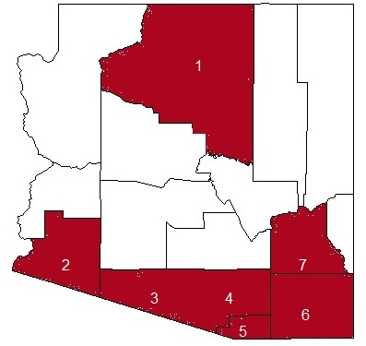
Improving early screening and diagnosis of autism in underserved populations through the AZLEND program
Eileen R. McGrath, PHD, Jennifer Andrews, MBA, and Sydney Rice, MD, MSc
University of Arizona Leadership Education in Neurodevelopmental and Related Disabilities (AZLEND), Department of Pediatrics
AZLEND Developmental Screening Technical Assistance Program
AZLEND improves and increases community medical practitioner compliance with the American Academy of Pediatrics’ (AAP) developmental surveillance and screening guidelines in early childhood.¹ Many medical practitioners feel overwhelmed by the task of changing clinic practice to accommodate an additional tool during an already activity laden well-child visit.
AZLEND Fellows alleviate this burden by providing technical assistance to community clinical practices through interviews with key staff, practice-specific implementation plan development, and targeted staff training on the screening tools and required changes to their clinic procedures. This technical assistance program is now in its 3rd year of implementation. Six sites were recruited to participate in each of the 2012 and 2013 academic years in 6 rural southern Arizona counties. All participating clinic sites provide care to diverse and underserved populations who are at risk for delayed diagnosis of developmental conditions
Participants
Participating clinics sites provide care to underserved populations including low income, native American, Hispanic, border, rural, and migrant populations.
Approach
AZLEND Fellows perform all activities under the supervision of a faculty member.
AZLEND Fellow teams conduct interviews with key staff to learn
Clinic flow and operations
Choice of tool (PEDS, ASQ, MCHAT-R/F)
Choice of delivery method and staff roles
Develop proposed process flow for incorporation of tool
plan represents the least amount of impact and time burden for the clinic
Conduct training that includes
In-depth training on the rationale behind developmental screening
How to use and score the tool
What the changes to process and staff roles and responsibilities
Record abstraction for all visit-eligible patients pre and post implementation
Provides change in number of formal screenings and on-time visits
Shows clinics their implementation success
Identifies needed changes
Sunset Community Health Center is currently the only site to implement the tool and provide pre- and post-implementation data. Results of the implementation are shown in Table 1. Gila Valley Clinic is scheduled for data collection in fall 2014. The UA Family Medicine Clinic is ready for implementation but EHR programming has delayed the implementation. The critical factor that was common at each of these locations was the presence of a physician champion who ensured clinic participation in the project.
Sunset Community Health Center’s success provides evidence that developmental screening programs can be successfully incorporated into rural and border community health practices using AZLEND Fellows as primary contacts and trainers. The experience indicates that success of implementation and continued adherence to developmental screening guidelines is dependent on a local physician advocate within the healthcare practice to ensure protocol adoption and demonstrates that systemic change can be achieved one clinic at a time.
Background Methods Results
.
References
American Academy of Pediatrics, Council on Children with Disabilities, Section on Developmental and Behavioral Pediatrics. Identifying infants and young children with developmental disorder in the medical home: an algorithm for developmental surveillance and screening. Pediatrics2006;118:405-20
9-, 18-, & 24-Month WCV | Pre | Post | Change
Surveillance only | 90% | 13% | -77%
Formal Screening | 0% | 85% | +85%
On-Time visits | 87% | 91% | +4%
Table 1. Results of screening implementation from Sunset CHC
 | Clinic (County) | Status | PEDS or ASQ |  |  |  | M-CHAT-R/F
 |  |  | Interview | Flow | Training | Implement | Interview | Flow | Training | Implement
1 | North Country Health Care (Coconino) | PEDS 2014 | Nov 2014 | Dec 2014 | Mar 2015 | Apr 2015
2 | Sunset Community Health Ctr (Yuma) | M-CHAT 2014 |  |  |  |  | Dec 2014 | Jan 2014 | Mar 2014 | Apr 2014
3 | Indian Health Services Sells Unit (Pima) | Incomplete 2014
4 | UA Family Medicine Clinic (Pima) | Incomplete 2014
5 | Mariposa Community Health Ctr (Santa Cruz) | Incomplete 2014
6 | Chiricahua Community Health Ctrs (Cochise) | Pulled Out 2013
7 | Gila Valley Clinic (Graham) | M-CHAT 2014 |  |  |  |  | Dec 2014 | Jan 2014 | Mar 2014 | Apr 2014
Figure 1. Counties in project.
Table 2. Status of participating sites

